Slide 1
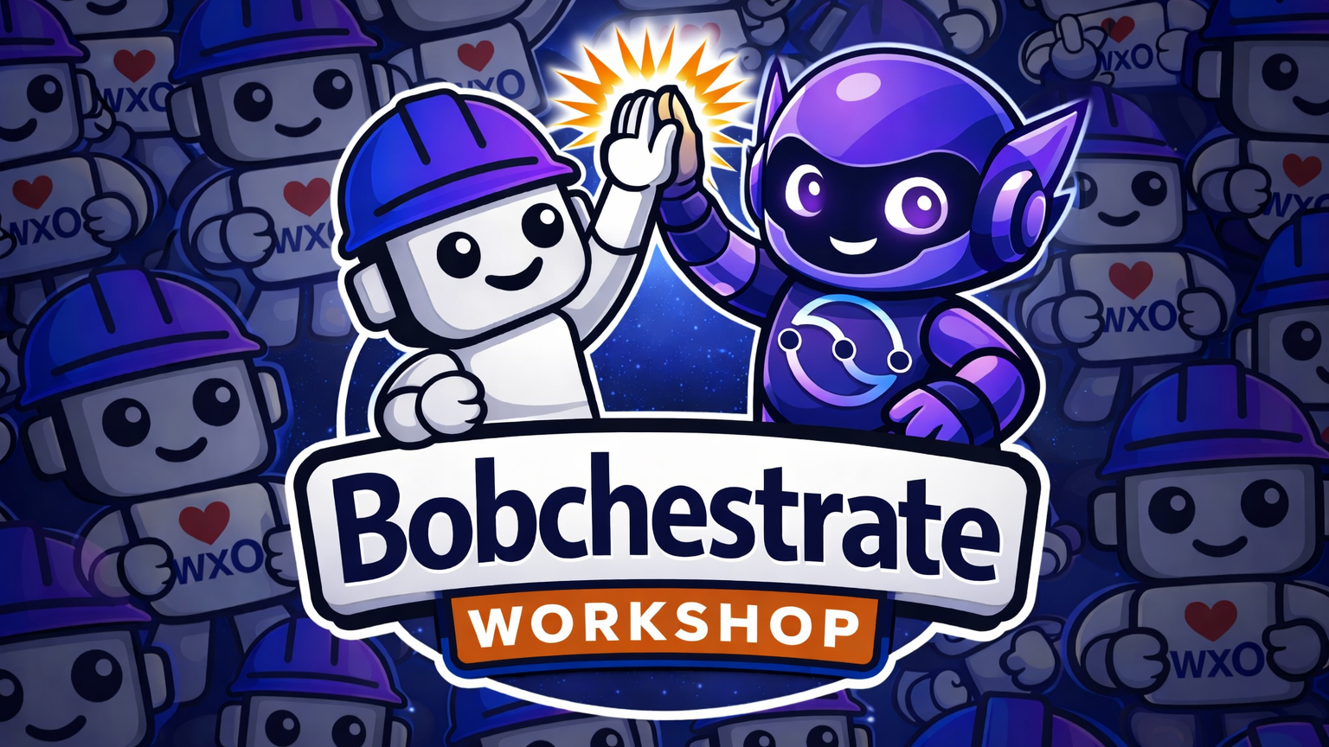
Bobchestrate Workshop
Building AI agents with IBM watsonx Orchestrate & IBM Bob
Beginner → Intermediate · 4.5–5 hours · 9 hands-on parts

Slide 2
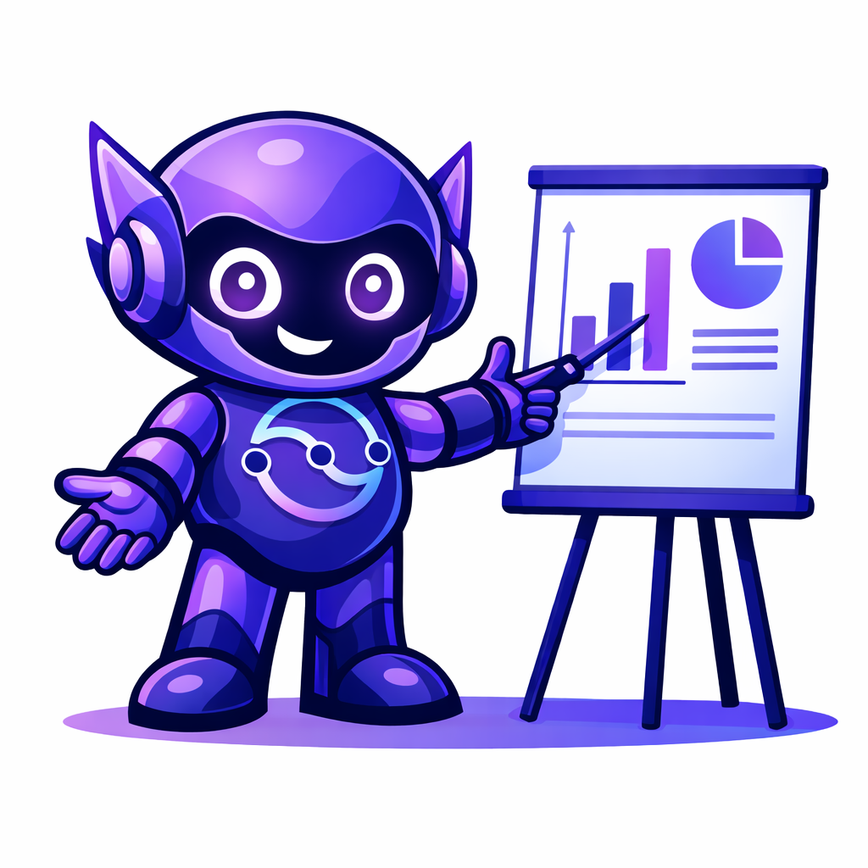
What this workshop is
A guided, hands-on path to building AI agents — with IBM Bob assisting you at every step.
270–300
9
Beginner
to Intermediate
MINUTES
PARTS
SKILL LEVEL
Full workshop, end to end
Progressive, hands-on modules
Advanced for Part 9
HOW THE TIME BREAKS DOWN
Core instruction
Setup & troubleshooting
Short breaks
Q&A & discussion
220 min
20–30 min
15–20 min
15–30 min

Slide 3



Before you begin
Have all of this ready — mismatched versions are the #1 cause of setup trouble.
Machine & environment
Accounts & tooling
Windows, macOS, or Linux with internet access
watsonx Orchestrate access (SaaS or Developer Edition)
At least 8 GB RAM and 500 MB free disk space
IBM Bob IDE installed — trial or instructor-provided
Python 3.11–3.13 installed (and basic Python knowledge)
Signed in to Bob with your IBM ID
uv package manager installed
A dedicated project folder for your agents

Slide 4
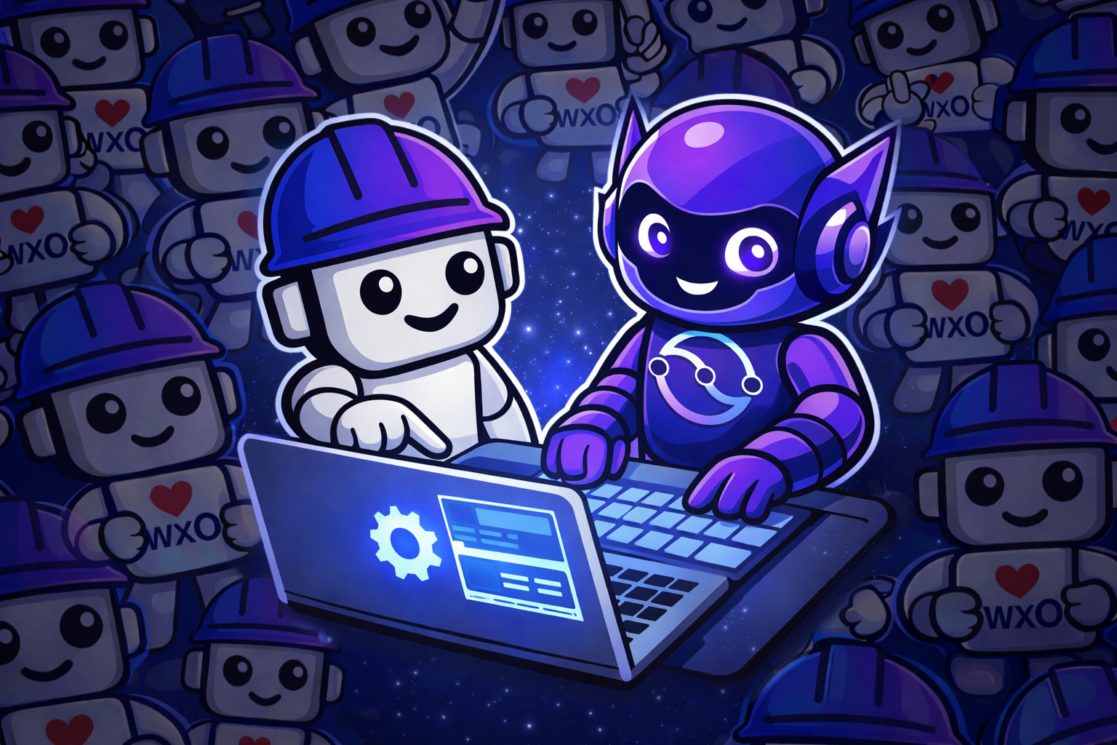


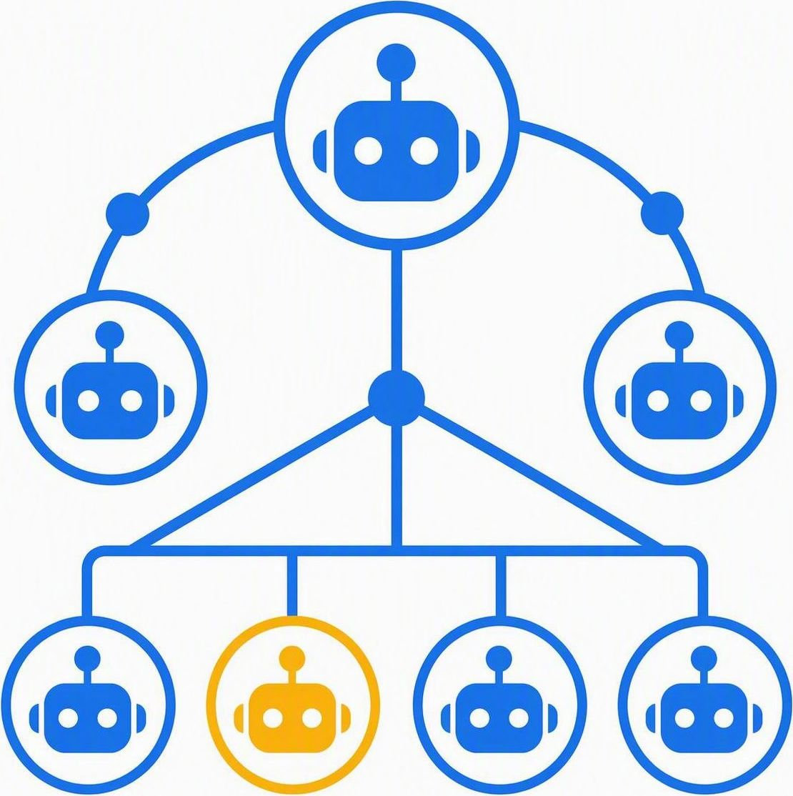
What you'll build
Four progressively more sophisticated systems
P2
P3–5
P6-7
P9
Hello World Agent
›
Customer Support System
›
Product Catalog System
›
Travel Planning System
Your first agent — the basics of configuration, instructions and behavior.
Custom tools, an FAQ knowledge base, an escalation agent, and safety guardrails.
An MCP-server-powered agent: product search, inventory and recommendations.
Multi-agent orchestration with specialized, collaborating expert agents.

Slide 5
The workshop journey
Nine parts — each builds a real capability on the one before.
1
Setup & Environment
2
Building Your First Agent
3
Adding Custom Tools
15 min
20 min
30 min
4
Knowledge & Collaborators
5
Guidelines & Guardrails
6
MCP Servers
25 min
20 min
25 min
7
Evaluations & Red-Teaming
8
Deployment
9
Multi-Agent Orchestration
30–35 min
20 min
30 min

Slide 6




Track your progress as you go
Every part ends with quick interactive quizzes — your answers and score save as you go
AS YOU LEARN
AS YOU GO
AT THE END
Interactive quizzes
Progress that persists
Score and celebrate
Multiple-choice at each part’s end
Sidebar shows answered count & score
Results screen tallies your score
Single-choice questions auto-submit
Saved in your browser across sessions
Colour-coded feedback by score band
Right answer shown when you miss one
Private — nothing sent to a server
Confetti when you complete them all

Slide 7
Anatomy of an agent
Part 2: Defined in a simple YAML spec — Bob helps you write and debug it.
Four mandatory fields
What an agent can do
spec_version
specification version, e.g. "v1"
Understand natural language
Execute tasks using tools
kind
native, external, or assistant
Collaborate with other agents
name
unique identifier for the agent
Access knowledge bases
llm
the model that powers the agent
Follow specific instructions
Extend with tools · collaborators · knowledge_base

Slide 8



Deep dive: customer support
Parts 3–5: From custom tools to responsible, safe AI
PART 3
PART 4
PART 5
Custom Tools
Knowledge & Collaborators
Guidelines & Guardrails
Python @tool functions
FAQ knowledge base for answers
When–Then guideline rules
Order status & refund processing
Specialized escalation agent
Content-safety guardrails
Query APIs and process data
Agent hierarchies for workflows
Responsible, consistent behavior

Slide 9

Scale and harden your agents
Parts 6–7: Reusable backends and rigorous testing
PART 6
PART 7
MCP Servers
Evaluations & Red-Teaming
Package related tools into a reusable server agents connect to.
Prove agents are correct, safe and robust before release.
Group tools by domain
Build evaluation datasets
Reusable across many agents
Run automated CLI evaluations
Standardized, easy integration
Red-team for vulnerabilities
Build a Product Catalog server
Measure performance metrics

Slide 10

Ship it: deploying your agent
Part 8: Take an evaluated agent from development to live
1
Import
2
Deploy
3
Connect & share
›
›
orchestrate agents import -f agent.yaml
orchestrate agents deploy -n <agent>
orchestrate channels webchat embed
Bring the agent into watsonx Orchestrate — it lands in a draft (undeployed) state.
Release it to the live SaaS environment so real users can reach it.
Enable channels, embed the chat widget in web apps, or publish to the catalog.
Evaluate before you promote
Validate performance, accuracy and security with the built-in evaluation framework first. Changes you make in draft reach the live environment only when you explicitly deploy.

Slide 11
Multi-agent orchestration
Part 9: A standalone advanced exercise – specialized agents that work together
Travel Concierge
Parent — routes each request to a specialist
Flight Specialist
Hotel Specialist
Activity Planner
Budget Advisor
Books flights
Manages stays
Suggests things to do
Analyses cost
Why? Clear separation of concerns · easier to maintain · better performance on specialized tasks · simpler to test

Slide 12
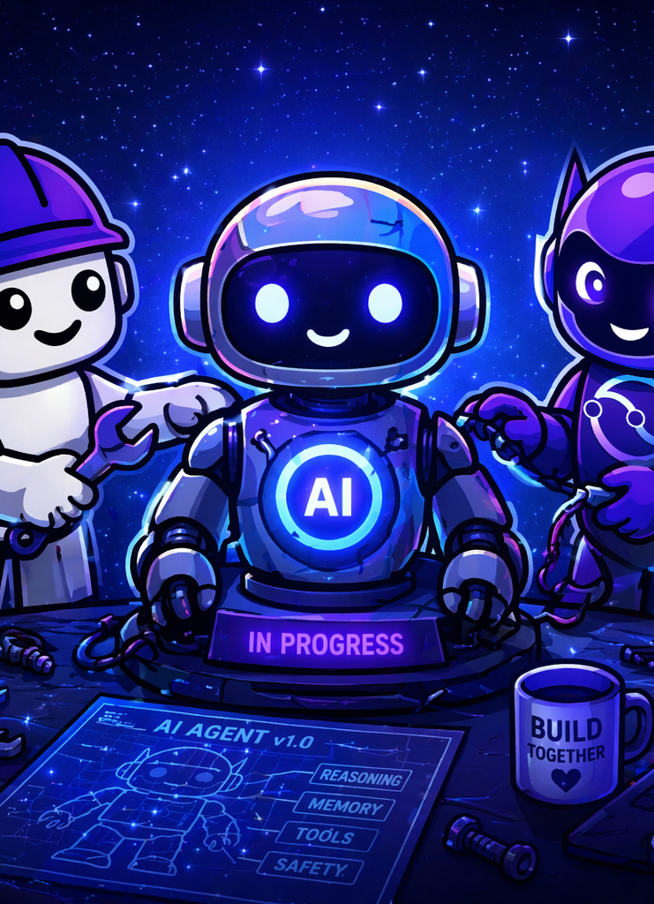
Ready to build?
YOU'RE READY
You'll leave able to design, build, evaluate and deploy production-ready AI agents on watsonx Orchestrate.
Install Python 3.11–3.13 and the uv package manager
Set up the IBM Bob IDE and sign in with your IBM ID
1
Confirm your watsonx Orchestrate access, then start Part 1
2
3
ibm.biz/bobchestrate

